Slide 1

Excellent film for the themes in this section of the course

Slide 2
Sociology 125
Lecture 12
Thinking about
equality, inequality and fairness
February 28, 2017

Slide 3
The idea of “social injustice”
People should get what the deserve
and deserve what they get
An inequality is unjust when:
(a) the inequality is unfair, and
(b) something could in principle be done to eliminate the unfairness.
Notes:
TWO PEOPLE, ONE STRUCK BY LIGHTENING EXAMPLE = unfair, they didn’t deserve that
Injustices: exclusion of blacks from white universities in parts of the US. – something could be done about this
Or: a person in a wheel chair because a paraplegic = bad luck, unfair; lack of curb cuts = injustice

Slide 4
The idea of “social injustice”
People should get what the deserve
and deserve what they get
An inequality is unjust when:
(a) the inequality is unfair, and
(b) something could in principle be done to eliminate the unfairness.
Notes:
TWO PEOPLE, ONE STRUCK BY LIGHTENING EXAMPLE = unfair, they didn’t deserve that
Injustices: exclusion of blacks from white universities in parts of the US. – something could be done about this
Or: a person in a wheel chair because a paraplegic = bad luck, unfair; lack of curb cuts = injustice

Slide 5
The idea of “social injustice”
People should get what the deserve
and deserve what they get
An inequality is unjust when:
(a) the inequality is unfair, and
(b) something could in principle be done to eliminate the unfairness.
Notes:
TWO PEOPLE, ONE STRUCK BY LIGHTENING EXAMPLE = unfair, they didn’t deserve that
Injustices: exclusion of blacks from white universities in parts of the US. – something could be done about this
Or: a person in a wheel chair because a paraplegic = bad luck, unfair; lack of curb cuts = injustice

Slide 6
Cases of Possible Injustice
Case 1. A police chief will only hire personal relatives – sons, daughters, cousins – as police officers.
Case 2. A small shop-owner is only willing to have his son or daughter become a co-owner of the store.
Case 3. A 30 year-old inherits $10 million from a grandfather
Case 4. In one of the richest countries in the world, there are millions of people, children and adults, who live in desperate poverty.

Slide 7
Two Conceptions of Justice/injustice:
FAIR PLAY vs FAIR SHARES
Fair play =
Moral judgment about procedures not outcomes.
“Fairness” means “equal playing field” -- no discrimination, no special privileges, etc. Result = high levels of inequalities of outcomes are fair so long as the outcomes were obtained through equal opportunity.
Fair share =
Moral judgment about outcomes, not just procedures.
“Fairness” means everyone is entitled to a share of society's resources sufficient to live a dignified, flourishing life (i.e. to have enough to be able to participate fully in the exercise of rights and liberties, to be able to exercise and develop one’s talents).

Slide 8
Two Conceptions of Justice/injustice:
FAIR PLAY vs FAIR SHARES
Fair play =
Moral judgment about procedures not outcomes.
“Fairness” means “equal playing field” -- no discrimination, no special privileges, etc. Result = high levels of inequalities of outcomes are fair so long as the outcomes were obtained through equal opportunity.
Fair share =
Moral judgment about outcomes, not just procedures.
“Fairness” means everyone is entitled to a share of society's resources sufficient to live a dignified, flourishing life (i.e. to have enough to be able to participate fully in the exercise of rights and liberties, to be able to exercise and develop one’s talents).

Slide 9
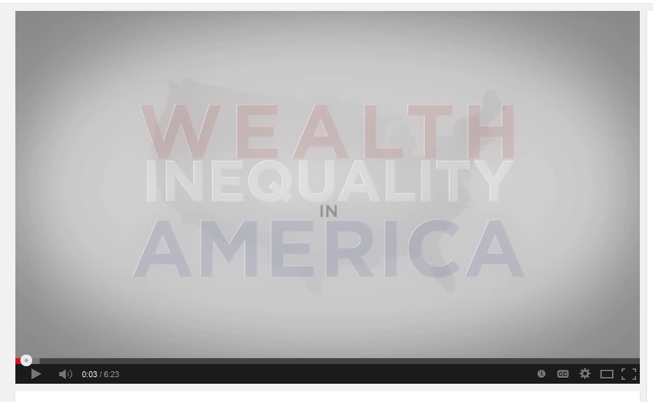
https://www.youtube.com/watch?v=QPKKQnijnsM

Slide 10
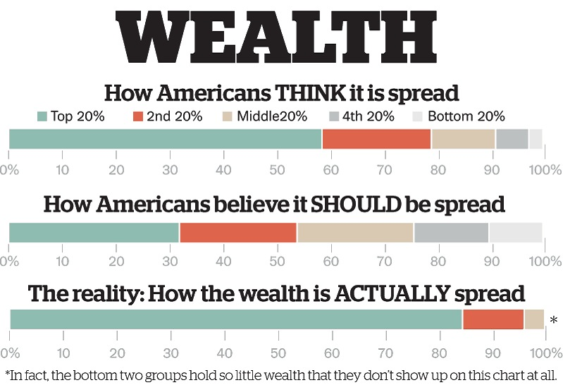
“How Americans spread the wealth,” by Robert Trigaux, St. Petersburg Times, Sunday October 3

Slide 11
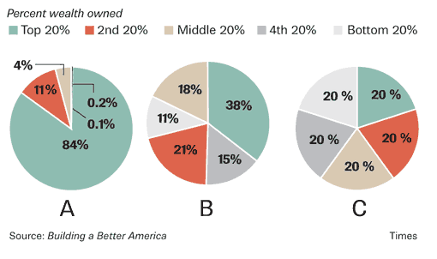
A, preferred by 10% of Americans is the United States
B, preferred by 47% of Americans, is Sweden
C, preferred by 43% of Americans, isn’t a real place

Slide 12
Biggest difficultly for FAIR PLAY principle =
the fate of children

Slide 13
Defenses of Unjust Inequalities

Slide 14
Conflicting Values
Some other value may be more important than justice: for example, private property or parental rights

Slide 15
II. Pragmatic Arguments to defend unjust inequality
A Pragmatic Argument = an argument that focuses on practical consequences rather than social justice as such.

Slide 16
The Pragmatic Argument
in favor of high levels of (unjust) economic inequality
Thesis 1: Inequality ➔ incentives ➔ people work harder ➔ prosperity ➔
ultimately benefits the poor
Thesis 2: Greater inequality ➔ greater incentives ➔ greater prosperity ➔
greater benefits for the poor
Underlying idea: inequalities generated by free-voluntary market processes are precisely the optimal level of inequality on pragmatic grounds
Thesis 3: Reducing inequality ➔ reduces incentives ➔ harms the poor
Practical policy implication = tax cuts for the very rich; “trickle down” economics

Slide 17
The Pragmatic Argument
in favor of high levels of (unjust) economic inequality
Thesis 1: Inequality ➔ incentives ➔ people work harder ➔ prosperity ➔
ultimately benefits the poor
Thesis 2: Greater inequality ➔ greater incentives ➔ greater prosperity ➔
greater benefits for the poor
Underlying idea: inequalities generated by free-voluntary market processes are precisely the optimal level of inequality on pragmatic grounds
Thesis 3: Reducing inequality ➔ reduces incentives ➔ harms the poor
Practical policy implication = tax cuts for the very rich; “trickle down” economics

Slide 18
The Pragmatic Argument
in favor of high levels of (unjust) economic inequality
Thesis 1: Inequality ➔ incentives ➔ people work harder ➔ prosperity ➔
ultimately benefits the poor
Thesis 2: Greater inequality ➔ greater incentives ➔ greater prosperity ➔
greater benefits for the poor
Underlying idea: inequalities generated by free-voluntary market processes are precisely the optimal level of inequality on pragmatic grounds
Thesis 3: Reducing inequality ➔ reduces incentives ➔ harms the poor
Practical policy implication = tax cuts for the very rich; “trickle down” economics

Slide 19
The Pragmatic Argument
in favor of high levels of (unjust) economic inequality
Thesis 1: Inequality ➔ incentives ➔ people work harder ➔ prosperity ➔
ultimately benefits the poor
Thesis 2: Greater inequality ➔ greater incentives ➔ greater prosperity ➔
greater benefits for the poor
Underlying idea: inequalities generated by free-voluntary market processes are precisely the optimal level of inequality on pragmatic grounds
Thesis 3: Reducing inequality ➔ reduces incentives ➔ harms the poor
Practical policy implication = tax cuts for the very rich; “trickle down” economics

Slide 20
The Pragmatic Argument
in favor of high levels of (unjust) economic inequality
Thesis 1: Inequality ➔ incentives ➔ people work harder ➔ prosperity ➔
ultimately benefits the poor
Thesis 2: Greater inequality ➔ greater incentives ➔ greater prosperity ➔
greater benefits for the poor
Underlying idea: inequalities generated by free-voluntary market processes are precisely the optimal level of inequality on pragmatic grounds
Thesis 3: Reducing inequality ➔ reduces incentives ➔ harms the poor
Practical policy implication = tax cuts for the very rich; “trickle down” economics

Slide 21
The Pragmatic Argument
in favor of high levels of (unjust) economic inequality
Thesis 1: Inequality ➔ incentives ➔ people work harder ➔ prosperity ➔
ultimately benefits the poor
Thesis 2: Greater inequality ➔ greater incentives ➔ greater prosperity ➔
greater benefits for the poor
Underlying idea: inequalities generated by free-voluntary market processes are precisely the optimal level of inequality on pragmatic grounds
Thesis 3: Reducing inequality ➔ reduces incentives ➔ harms the poor
Practical policy implication = tax cuts for the very rich; “trickle down” economics

Slide 22
Criticisms of the Pragmatic Argument for Inequality
“Endogenous preferences”: increasing inequality affects the incentive-preferences of people
The role of power in generating inequality
What is the difference between an “incentive” and “extortion”?
    If a robber holds a gun to your head and says “your money or your life”, is paying the robber an “incentive” for not shooting you?
    Elites always claim that privilege is necessary as an incentive, but this can just be an exercise of power
3. “Excess Inequality” = more inequality than is really needed for incentives

Slide 23
Incentives and “Endogenous preferences”
 | Low Inequality World | High Inequality World
CEO | $250,000 | $7.5 million
Level 1 | $170,000 | $2 million
Level 2 | $120,000 | $500,000
Level 3 | $80,000 | $200,000
Level 4 | $50,000 | $100,000
Level 5 | $35,000 | $50,000
Workers | $25,000 | $25,000
Ratio Top: bottom | 10:1 | 300:1

Slide 24
Criticisms of the Pragmatic Argument for Inequality
“Endogenous preferences”: increasing inequality affects the incentive-preferences of people
The role of power in generating inequality
What is the difference between an “incentive” and “extortion”?
    If a robber holds a gun to your head and says “your money or your life”, is paying the robber an “incentive” for not shooting you?
    Elites always claim that privilege is necessary as an incentive, but this can just be an exercise of power
3. “Excess Inequality” = more inequality than is really needed for incentives

Slide 25
Criticisms of the Pragmatic Argument for Inequality
“Endogenous preferences”: increasing inequality affects the incentive-preferences of people
The role of power in generating inequality
What is the difference between an “incentive” and “extortion”?
    If a robber holds a gun to your head and says “your money or your life”, is paying the robber an “incentive” for not shooting you?
    Elites always claim that privilege is necessary as an incentive, but this can just be an exercise of power
3. “Excess Inequality” = more inequality than is really needed for incentives

Slide 26
The Pragmatic Argument
against high levels of economic inequality
Thesis 1: High Inequality ➔ resentment and conflict ➔ erodes community and cooperation ➔ lowers productivity ➔ reduces prosperity
Thesis 2: High inequality ➔ concentrations of wealth ➔ concentrations of power ➔ erodes democracy
Thesis 3: High inequality harms almost everyone, even the relatively affluent

Slide 27
The Pragmatic Argument
against high levels of economic inequality
Thesis 1: High Inequality ➔ resentment and conflict ➔ erodes community and cooperation ➔ lowers productivity ➔ reduces prosperity
Thesis 2: High inequality ➔ concentrations of wealth ➔ concentrations of power ➔ erodes democracy
Thesis 3: High inequality harms almost everyone, even the relatively affluent

Slide 28
The Pragmatic Argument
against high levels of economic inequality
Thesis 1: High Inequality ➔ resentment and conflict ➔ erodes community and cooperation ➔ lowers productivity ➔ reduces prosperity
Thesis 2: High inequality ➔ concentrations of wealth ➔ concentrations of power ➔ erodes democracy
Thesis 3: High inequality harms almost everyone, even the relatively affluent

Slide 29
The Pragmatic Argument
against high levels of economic inequality
Thesis 1: High Inequality ➔ resentment and conflict ➔ erodes community and cooperation ➔ lowers productivity ➔ reduces prosperity
Thesis 2: High inequality ➔ concentrations of wealth ➔ concentrations of power ➔ erodes democracy
Thesis 3: High inequality harms almost everyone, even the relatively affluent

Slide 30
The Pragmatic Argument
against high levels of economic inequality
Thesis 1: High Inequality ➔ resentment and conflict ➔ erodes community and cooperation ➔ lowers productivity ➔ reduces prosperity
Thesis 2: High inequality ➔ concentrations of wealth ➔ concentrations of power ➔ erodes democracy
Thesis 3: High inequality harms almost everyone, even the relatively affluent

Slide 31
The Pragmatic Argument
against high levels of economic inequality
Thesis 1: High Inequality ➔ resentment and conflict ➔ erodes community and cooperation ➔ lowers productivity ➔ reduces prosperity
Thesis 2: High inequality ➔ concentrations of wealth ➔ concentrations of power ➔ erodes democracy
Thesis 3: High inequality harms almost everyone, even the relatively affluent

Slide 32
The Pragmatic Argument
against high levels of economic inequality
Thesis 1: High Inequality ➔ resentment and conflict ➔ erodes community and cooperation ➔ lowers productivity ➔ reduces prosperity
Thesis 2: High inequality ➔ concentrations of wealth ➔ concentrations of power ➔ erodes democracy
Thesis 3: High inequality harms almost everyone, even the relatively affluent

Slide 33
The Pragmatic Argument
against high levels of economic inequality
Thesis 1: High Inequality ➔ resentment and conflict ➔ erodes community and cooperation ➔ lowers productivity ➔ reduces prosperity
Thesis 2: High inequality ➔ concentrations of wealth ➔ concentrations of power ➔ erodes democracy
Thesis 3: High inequality harms almost everyone, even the relatively affluent

Slide 34
The empirical effects
of inequality on wellbeing
from Wilkkenson and Pikett,
The Spirit Level

Slide 35
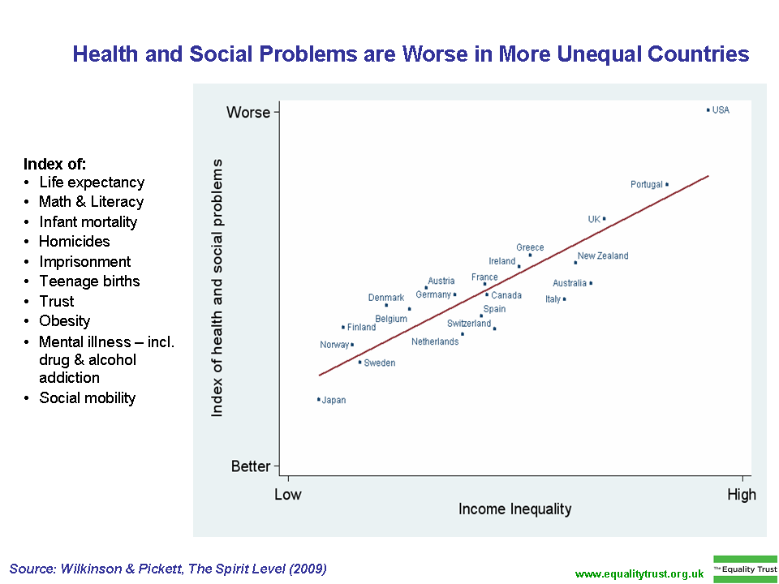

Slide 36
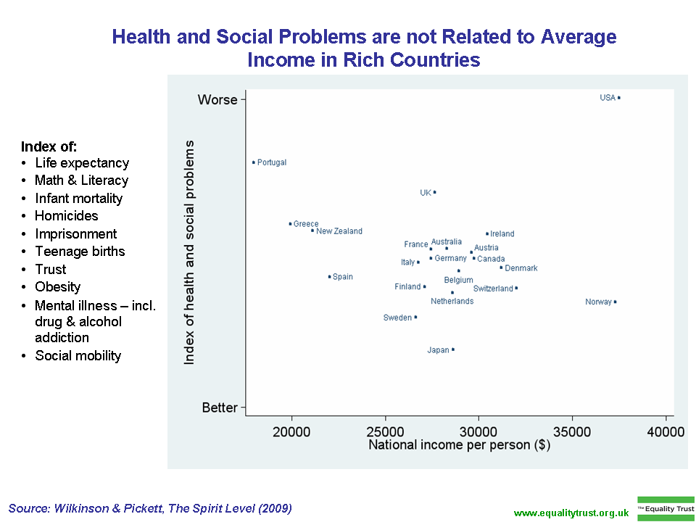

Slide 37
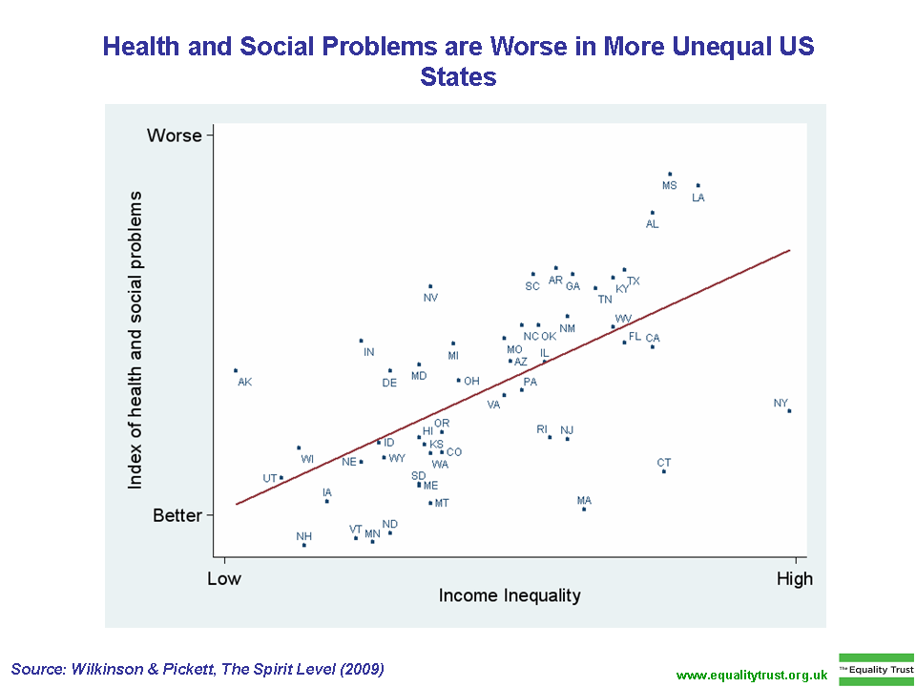
Wisconsin

Slide 38
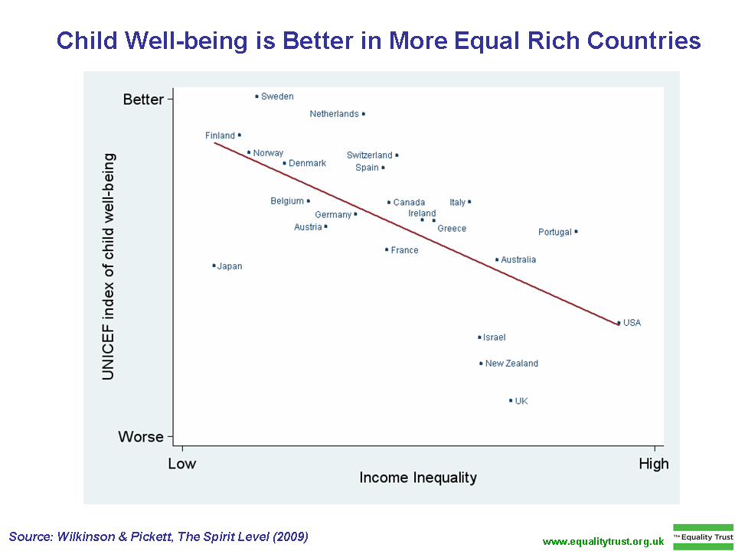

Slide 39
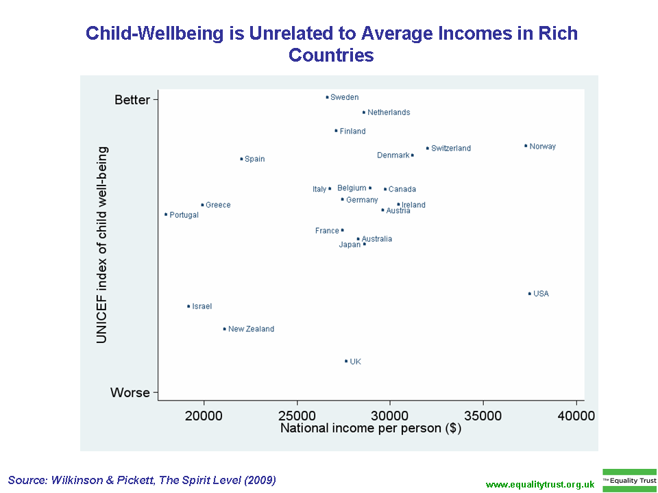

Slide 40
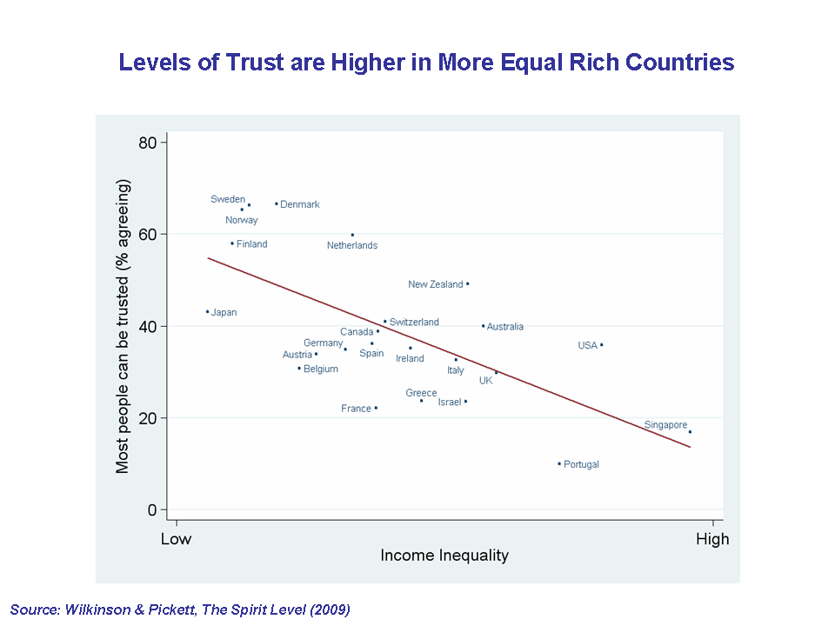

Slide 41
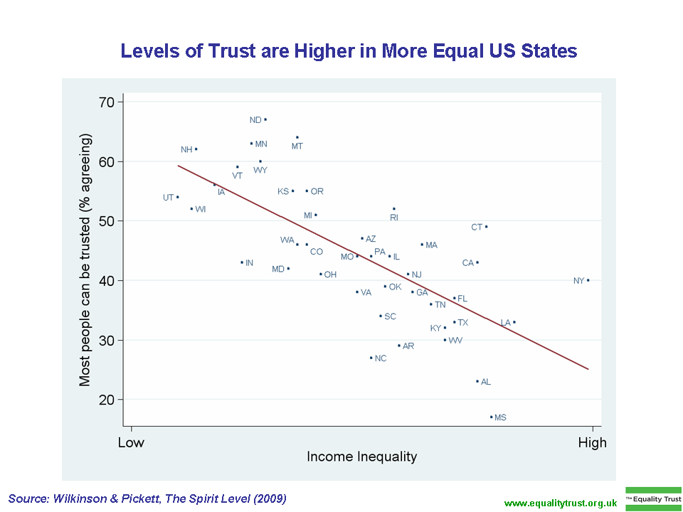
Wisconsin

Slide 42
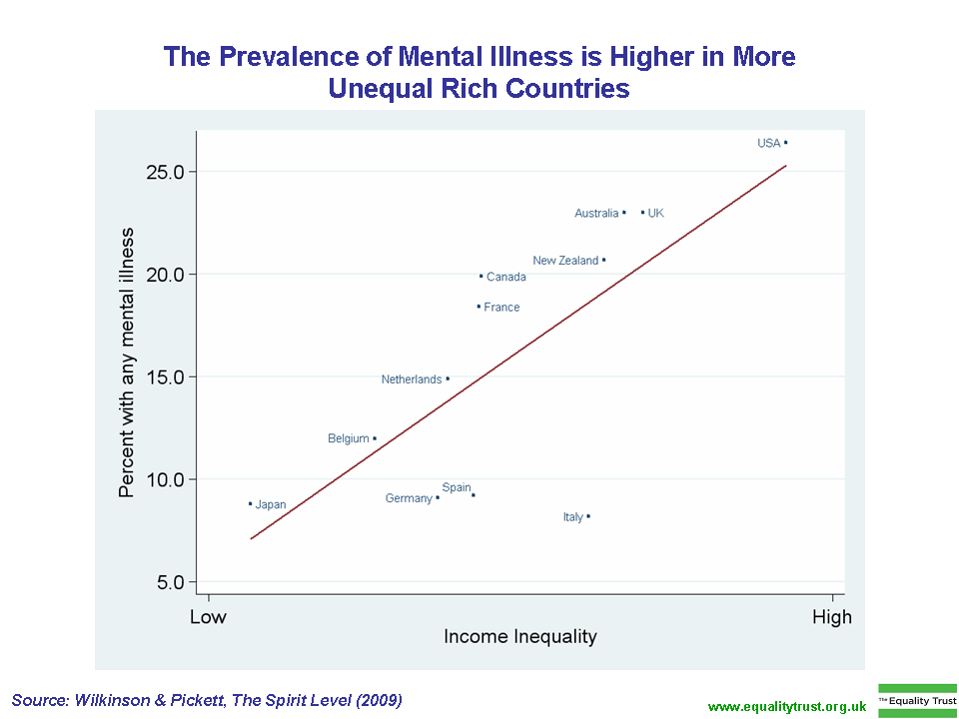

Slide 43
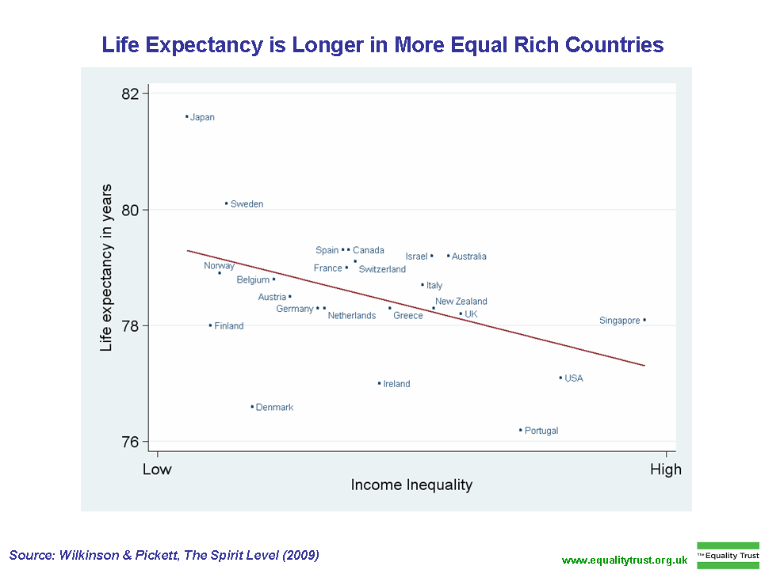

Slide 44
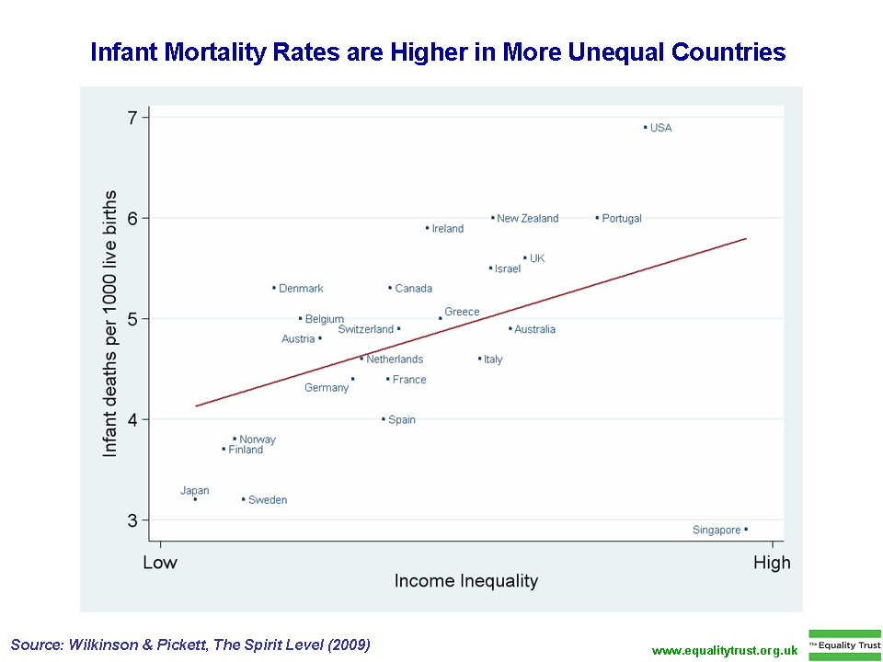

Slide 45
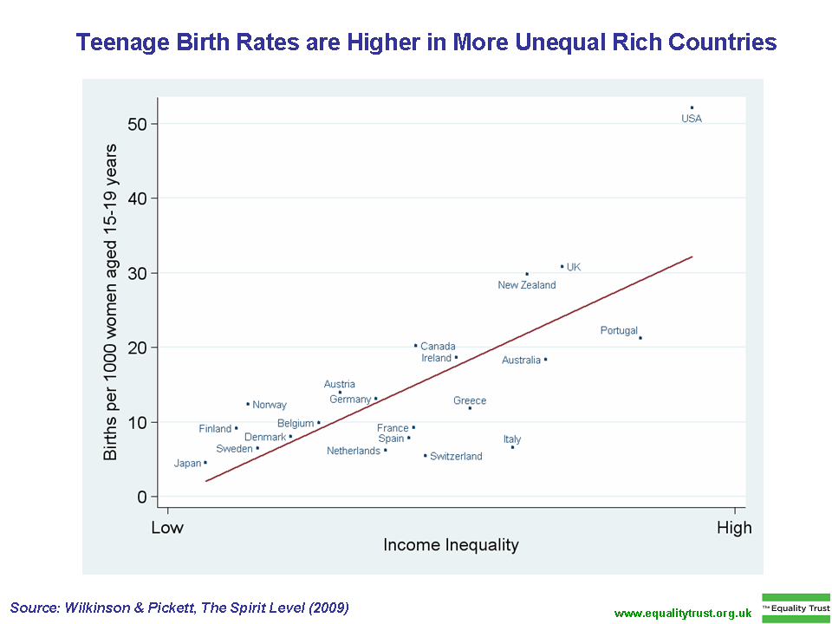

Slide 46
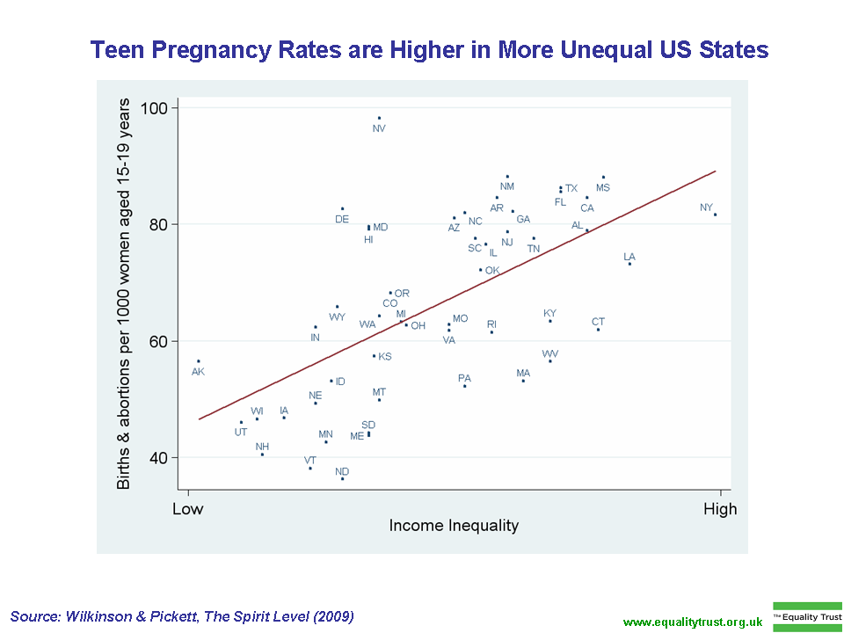
Wisconsin

Slide 47
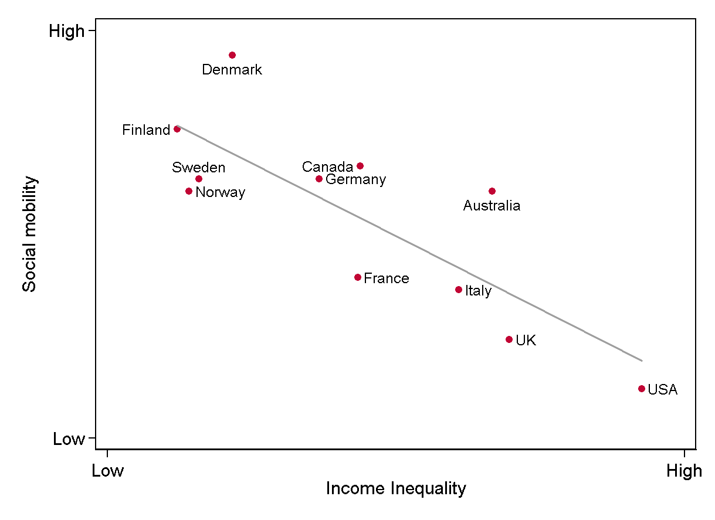
Social mobility is lower in more unequal countries
Wilkinson & Pickett, The Spirit Level
www.equalitytrust.org.uk

